Slide 1


Slide 2

Reverse Brainstorming
Course Code : MSTS502P
Course Title :
Credits : 1
Prerequisites : NA
Antirequisites : NA

Slide 3


Introduction
"Reverse brainstorming" is a creative problem-solving technique used to generate innovative solutions by identifying and reversing the problems or challenges associated with a given situation.

Slide 4
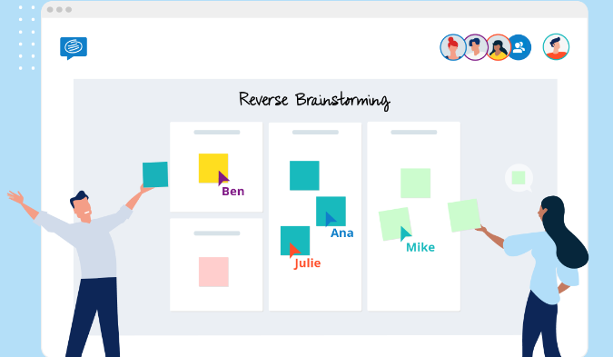
Instead of brainstorming ideas to solve a problem directly, reverse brainstorming encourages participants to think of ways to exacerbate or cause the problem.

Slide 5
How Reverse Brainstorming works?
Define the Problem: Clearly articulate the problem you want to address. Be specific about the challenges or obstacles you're facing.
Flip the Question: Instead of asking, "How can we solve this problem?" ask, "How can we create or worsen this problem?" This shift in perspective encourages participants to think in unconventional ways.

Slide 6

3. Generate Ideas to Exacerbate the Problem:
Encourage participants to brainstorm ideas that would make the problem worse. The goal is to explore all possible aspects and dimensions of the problem. This may feel counterintuitive, but it helps identify hidden assumptions and brings attention to elements that may be overlooked.

Slide 7
3. Generate Ideas to Exacerbate the Problem:
Encourage participants to brainstorm ideas that would make the problem worse. The goal is to explore all possible aspects and dimensions of the problem. This may feel counterintuitive, but it helps identify hidden assumptions and brings attention to elements that may be overlooked.
4. Record Ideas Without Judgment:
Create a list of all the ideas without evaluating or criticizing them. The focus at this stage is on quantity, not quality. Allow for a free flow of ideas, and make sure everyone feels comfortable contributing.

Slide 8
How Reverse Brainstorming Works
5. Analyze and Reverse Ideas:
Once you have a list of ideas on how to make the problem worse, review each one and consider how it could be reversed or modified to become a potential solution. This involves taking the negative aspects and turning them into positive, constructive suggestions.
6. Identify Solutions:
Look for patterns or common themes among the reversed ideas. Extract the positive elements and transform them into potential solutions for the original problem.

Slide 9
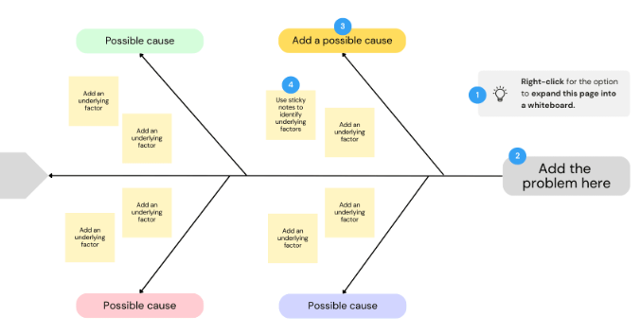
How Reverse Brainstorming Works
7. Evaluate and Refine: Evaluate the potential solutions based on feasibility, effectiveness, and practicality. Refine and develop the most promising ideas into actionable strategies.
8. Implement: Put the selected solutions into action. Monitor and assess the outcomes, and be open to adjustments as needed.

Slide 10
Steps to conduct a Reverse Brainstorming
Define the problem
Reverse the problem
Generate ideas
Analyze and reverse again
Flip the ideas
Evaluate and refine
Implement the solutions

Slide 11
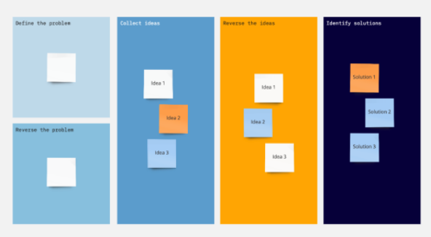
1.Define the problem:
Clearly articulate the problem or challenge you want to address. Ensure that all participants have a clear understanding of the issue.

Slide 12
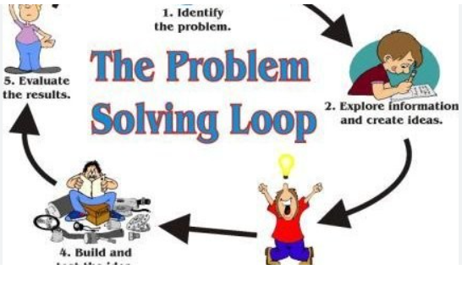
2.Reverse the problem:
Encourage participants to think about how to make the problem worse. Ask questions like, "What could we do to create this problem deliberately?" or "How could we maximize the negative impact of this issue?"

Slide 13
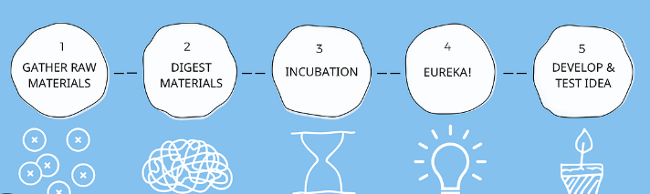
3.Generate ideas: Have participants brainstorm and list as many ways as possible to exacerbate the problem. Encourage them to think creatively and not worry about practicality at this stage.

Slide 14

4.Analyze and reverse again:
Once you have a list of reverse ideas, analyze them and consider how they relate to the original problem. Sometimes, you may find that reversing the problems highlights underlying causes or factors you hadn't considered.

Slide 15
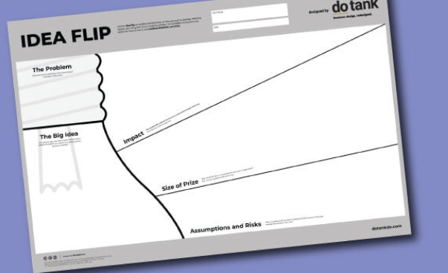
5.Flip the ideas:
Now, take the reverse ideas and flip them to generate potential solutions. Think about how you can turn these negative actions into positive ones to address the original problem.

Slide 16
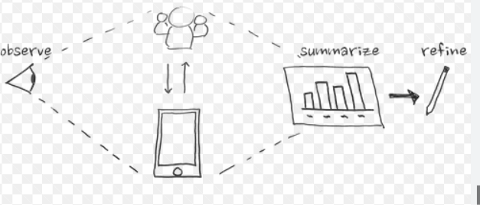
6.Evaluate and refine:
Review the flipped ideas and evaluate their feasibility and potential effectiveness. Refine and prioritize the most promising solutions.

Slide 17

7.Implement the solutions:
Once you have identified viable solutions, create an action plan for implementing them to address the original problem.

Slide 18
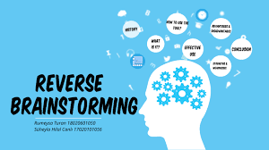
When to use Reverse Brainstorming
Stuck in a creative rut:
Use reverse brainstorming when a team is facing creative blocks and struggling to generate innovative ideas.
It can help break the mental barriers by approaching the problem from a different angle.

Slide 19

2.Identifying potential obstacles:
Prior to implementing a new project or strategy, reverse brainstorming can be employed to identify potential obstacles, challenges, or risks.
This allows teams to proactively address these issues before they become significant problems.

Slide 20
3. Problem reframing:
When a problem has been framed in a certain way for a long time, it can be challenging to break out of that mindset.
Reverse brainstorming helps in reframing the problem by exploring ways to make it worse.
This can lead to fresh insights and perspectives.

Slide 21
4.Encouraging unconventional thinking:
Traditional brainstorming often follows a positive, solution-oriented approach.
Reverse brainstorming, on the other hand, encourages thinking in the opposite direction.
It allows for the exploration of unconventional ideas and solutions that might not be considered in a typical brainstorming session.

Slide 22

5. Overcoming groupthink:
In a group setting, there might be a tendency for everyone to conform to a particular viewpoint.
Reverse brainstorming disrupts this pattern by encouraging individuals to think in a counterintuitive manner, which can lead to a wider range of ideas.

Slide 23

6. Innovative product development:
When designing a new product, reverse brainstorming can be used to uncover potential flaws or weaknesses in the product concept.
By imagining ways to make the product fail, the team can preemptively address these issues.

Slide 24
7. Encouraging participation:
In situations where certain team members may be hesitant to voice their opinions or ideas, reverse brainstorming can create a more inclusive environment.
It allows individuals to contribute without the pressure of proposing solutions initially.

Slide 25
8.Breaking down mental barriers:
Reverse brainstorming is effective in breaking down mental barriers and challenging preconceived notions.
It prompts individuals to think outside the box and consider possibilities they might not have explored otherwise.

Slide 26
When to use Reverse Brainstorming
Stuck in a creative rut:
Use reverse brainstorming when a team is facing creative blocks and struggling to generate innovative ideas.
It can help break the mental barriers by approaching the problem from a different angle.

Slide 27
Identifying potential obstacles:
Prior to implementing a new project or strategy, reverse brainstorming can be employed to identify potential obstacles, challenges, or risks.
This allows teams to proactively address these issues before they become significant problems.

Slide 28

Benefits of Reverse Brainstroming
Reverse brainstorming can be a valuable tool when traditional brainstorming methods aren't producing innovative solutions or when you need to dig deeper into the root causes of a problem.
It encourages participants to think critically and creatively to find new perspectives and solutions.

Slide 29

THANK YOU

